Slide 1
Spring framework
Bharani Chennu
June 10, 2015

Slide 2
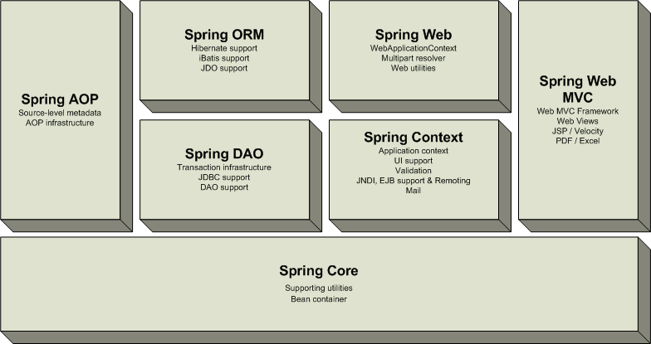
SPRING MODULES

Slide 3
Spring Core

Slide 4
Core Concepts
Dependency Injection or Inversion of control
BeanFactory
ApplicationContext
Spring Container
Bean

Slide 5
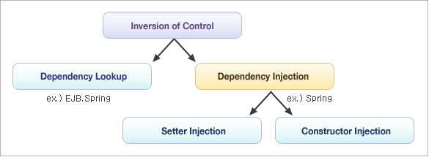
Types of Dependency Injection

Slide 6
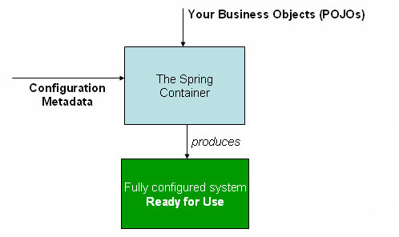
How Spring works and Spring Container

Slide 7
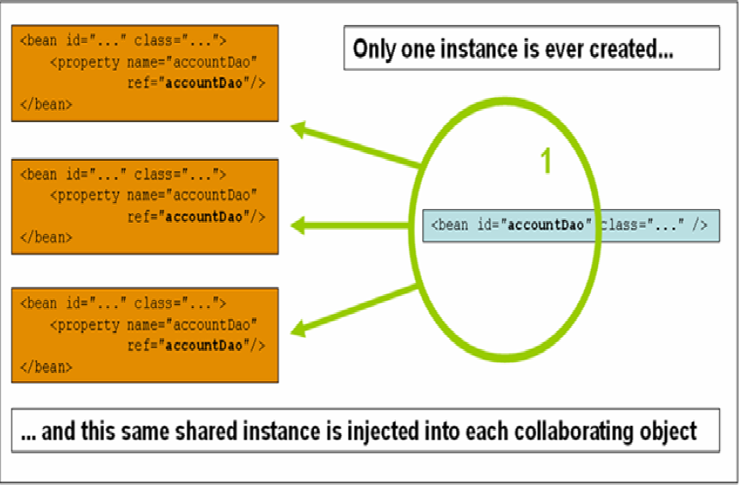
Bean scopes -singleton [default] ,prototype , request , session ,globalSession

Slide 8
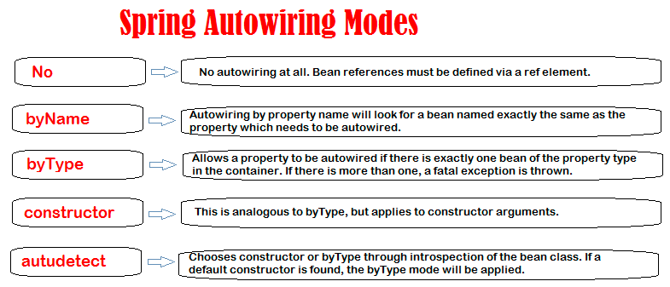
Autowiring

Slide 9
Bean configuration with xml
<!-- this bean can only be used as a parent for another -->
<bean id="parental" abstract="true">
<property name="message" value="CISCO Systems"/>
</bean>
<bean id="helloFactory" class="core.HelloWorldBeanFact" factory-method="createInstance">
</bean>
<!-- setter injection -->
<bean id="hello" class="core.HelloWorldBean" autowire="byType" parent="parental">
<!-- <property name="message" value="CISCO"/>-->
<!-- <property name="help" ref="help"></property>-->
</bean>

Slide 10
<context:component-scan> - Autoscan
@Component – generic and can be used across application.
@Service – annotate classes at service layer level.
@Controller – annotate classes at presentation layers level, mainly used in Spring MVC
@Repository – annotate classes at persistence layer, which will act as database repository.
<context:component-scan base-package="comp"></context:component-scan>
This is different from <context:annotation-config/> which is for @Autowired.

Slide 11
Spring AOP

Slide 12
Aspect Oriented Programming
Aspect
Advice
Joinpoint
Pointcut
Target
Proxy
Weaving – Spring does it at run-time
Types of advice – After finally, After returning , After Throwing , Before , Around

Slide 13
Aspect – Transaction management
@Aspect
public class SystemArchitecture {
@Pointcut("execution(* com.xyz.someapp..service.*.*(..))")
public void businessService() {}
}
<aop:config>
<aop:advisor pointcut="com.xyz.someapp.SystemArchitecture.businessService()" advice-ref="tx-advice"/> </aop:config>
<tx:advice id="tx-advice">
<tx:attributes> <tx:method name="*" propagation="REQUIRED"/>
</tx:attributes>
</tx:advice>

Slide 14
Spring DAO

Slide 15
Spring DAO with JDBC
Spring's data access framework addresses common difficulties developers face when working with databases in applications such as :
Resource management - automatically acquiring and releasing database resources
Exception handling - translating data access related exception to a Spring data access hierarchy
Abstraction for BLOB and CLOB handling
JDBC – JdbcTemplate
int rowCount = this.jdbcTemplate.queryForObject("select count(*) from t_actor", Integer.class);

Slide 16
Spring ORM

Slide 17
Spring integration with hibernate
<bean id="dataSource" class="org.springframework.jdbc.datasource.DriverManagerDataSource">
<property name="driverClassName" value="${jdbc.driverClassName}" />
<property name="url" value="${jdbc.url}" />
<property name="username“ value="${jdbc.username}" />
<property name="password" value="${jdbc.password}" /> </bean>
<bean id="sessionFactory"
class="org.springframework.orm.hibernate4.LocalSessionFactoryBean">
<property name="dataSource" ref="dataSource" />
<property name="configLocation" value="classpath:hibernate.cfg.xml" /> </bean>
<bean id="userDao" class="comp.orm.UserDAOImpl">
<constructor-arg> <ref bean="sessionFactory" /> </constructor-arg>
</bean>

Slide 18
Spring MVC

Slide 19
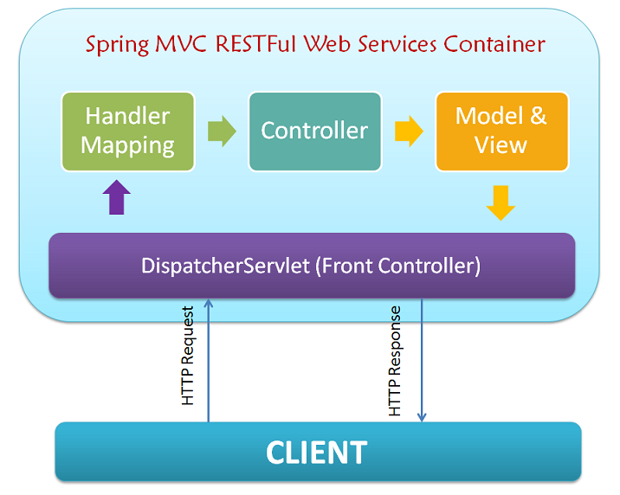

Slide 20
Configure Spring for a J2EE webapp [ web.xml ]
<web-app>
<servlet> <servlet-name>dispatcher</servlet-name>
<servlet-class>
org.springframework.web.servlet.DispatcherServlet
</servlet-class>
<load-on-startup>1</load-on-startup>
</servlet>
<servlet-mapping>
<servlet-name>dispatcher</servlet-name>
<url-pattern>/</url-pattern>
</servlet-mapping>
</web-app>

Slide 21
Spring MVC Controller
@Controller
public class UserController {
@Autowired
private UserDAO userDao;
@RequestMapping(value="/user.do")
public ModelAndView home() {
ModelAndView model = new ModelAndView("hello");
model.addObject("userList", listUsers);
return model;
}
}

Slide 22
Spring REST

Slide 23
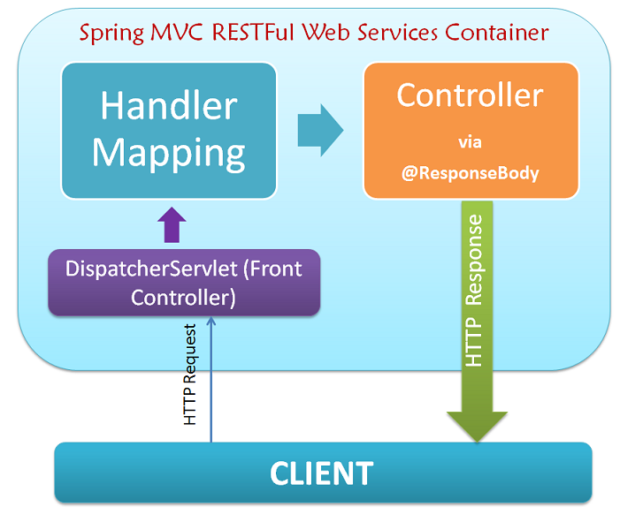
Spring REST

Slide 24
Q&A

